Slide 1
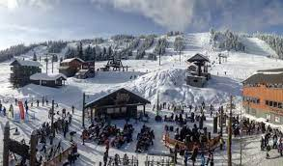
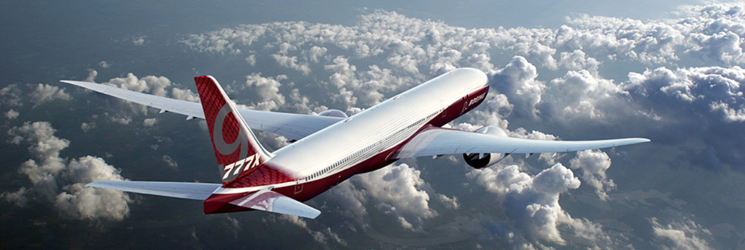
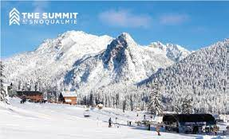
Special
Event
Boeing Leadership Network Newsletter
February 2023
BLN WINTERFEST-NIGHT ON THE SLOPES
35th Annual Event at The Summit at Snoqualmie
Link to Event Details and Registration links to Summit at Snoqualmie
When: Tuesday, February 28th from 4-9:30pm
Where: The Summit at Snoqualmie
Ticket Information – For All Boeing Employees
Rentals and Lessons available at additional cost
**ATTENTION** - All tickets must be purchased PRIOR to the
event and ONLINE. NO SALES available at the resort!
This is a change by the resort.

